Slide 1
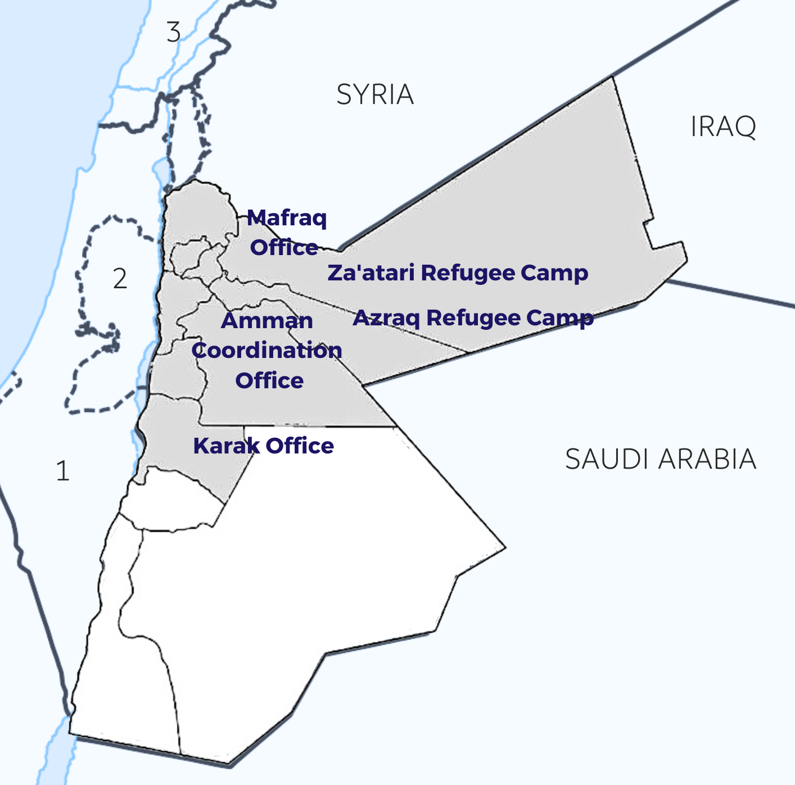
2023
Acted in Jordan
Acted in Jordan at a glance
Main sectors of intervention
10 projects ongoing in 2023
5m+
beneficiaries
Inclusive Economic Opportunities
110 staff
employed
5 million USD
annual budget
Collaborative and Resilient Ecosystem Management
Strengthening Institutions and Civil Society
Our presence in Jordan
Since 2005, Acted has been a key actor in the promotion of the humanitarian-development nexus in Jordan. Currently, Jordan remains one of the countries most affected by the Syrian crisis, hosting an estimated 1.3 million refugees. The influx of refugees since 2011 compounded Jordan’s already slow economic growth, exacerbating poverty and inequality. Already vulnerable groups are particularly impacted, including women (14.49% labour force participation rate) and youth (46.1% unemployed). Economic engagement within Syrian refugee communities is further challenged by legal frameworks, including the job levels and types of sectors accessible to Syrians. In response, Acted in Jordan has been transitioning from a focus on specialized humanitarian WASH interventions in camp settings to supporting Jordanians and refugee communities alike in socioeconomic development along three programmatic pillars: 1. Livelihoods and Economic Development. 2. Collaborative Environmental Sustainability. 3. Inclusive Community Engagement and Cohesion.
In close partnership with target populations and key stakeholders, including local governance bodies, civil
society organisations and inter-agency working groups, Acted's commitment to the improvement of livelihoods and economic development is at the centre of its programmatic response in Jordan. In doing so, Acted
Map key:
Coordination offices
1 Israel
Area offices
Occupied Palestinian
Territories
3 Lebanon
Implementation zone
incorporates environmental action and circular economic models in order to enable community resilience, thereby ensuring basic needs are met and social cohesion is promoted.
Acted’s partners in Jordan
Acted in Jordan works towards a
world
Acted Sudan works towards a
world

Slide 2
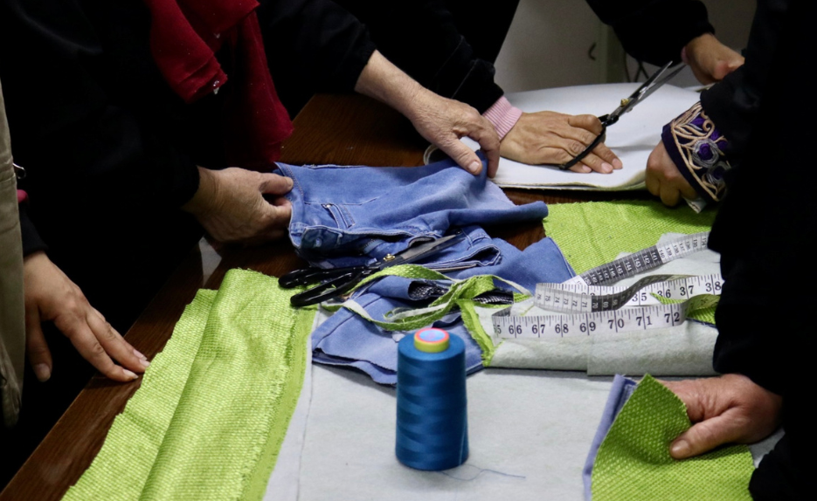
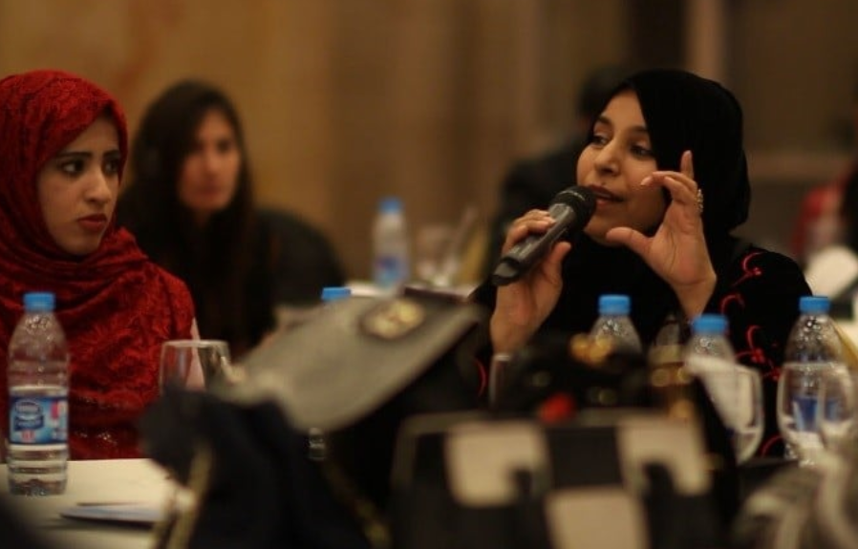
2023
What we do in Jordan
Livelihoods and Economic Development
Acted promotes increased income generation and self-reliance through self-employment, entrepreneurship and business skill development. This includes building soft skills and technical capacities of vulnerable Jordanians and Syrian refugees through sustainable ecosystem management and market-based approaches. In 2023, Acted is targeting 336 individuals with business development training activities, as well as supporting 509 individuals through business development grants. Through cash-for-work programmes, Acted is also providing short-term employment opportunities and training to 477 participants, whilst supporting local communities through infrastructure projects including the rehabilitation of urban green spaces, local heritage preservation, and reforestation schemes.
Collaborative environmental sustainability
Acted aims to contribute to improving environmental and health conditions by installing sustainable and green infrastructure in Jordan. In 2023, this includes constructing a wastewater treatment plant in Azraq municipality to promote wastewater reuse in agriculture. In addition, Acted will target reforestation, soil erosion mitigation and restoration, natural resource management and climate adaptation techniques are leveraged through Acted’s THRIVE flagship, to ensure sustainable conservation of resources. Acted Jordan also works with approximately to promote climate-smart behaviour change at the household, livelihood and community level, targeting approximately 658 members of local municipalities in 2023 through community-led dialogue forums, advocacy and initiatives which mobilise Jordanian and refugee communities to inciting climate driven leadership and change.
Picture illustrating
section 2
Inclusive Community Engagement & Cohesion
Acted Jordan equips marginalised groups and grassroots Civil Society Organisations (CSOs) with the knowledge, tools, skills, and access to increase their engagement and impact in policy and community development. In 2023, Acted works with 14 CSOs to improve their service provision for local populations as well as their capacity to engage in policy dialogue. Acted also provides Life, Social and Emotional skills trainings, as well as opportunities for participants to practice leadership, communication, and advocacy skills. Across its projects, Acted aims to create opportunities for groups from different social backgrounds to interact with one another towards a common goal. This is achieved through exchange events, community forums and shared-business creation.
Contact
Acted Jordan Director at santiago.alexander@acted.org

